Slide 1
Branding
+ Style guides
Yukiko Ishida

Slide 2
Build a brand
Notes:
Let’s talk about a brand. Why is it important? What is conveyed by a brand?

Slide 3
Values
Personality
trust
Recognition
Notes:
Branding helps give customers and employees a sense of your company’s…
Values: things like honesty, quality, speediness
Personality: hardcore tough mudder, crazy teen, tight-upper lip
Trust: Building a relationship with the customer.
Recognition: something to remember you by. It’s the one with the…
You can use design to convey these concepts

Slide 4
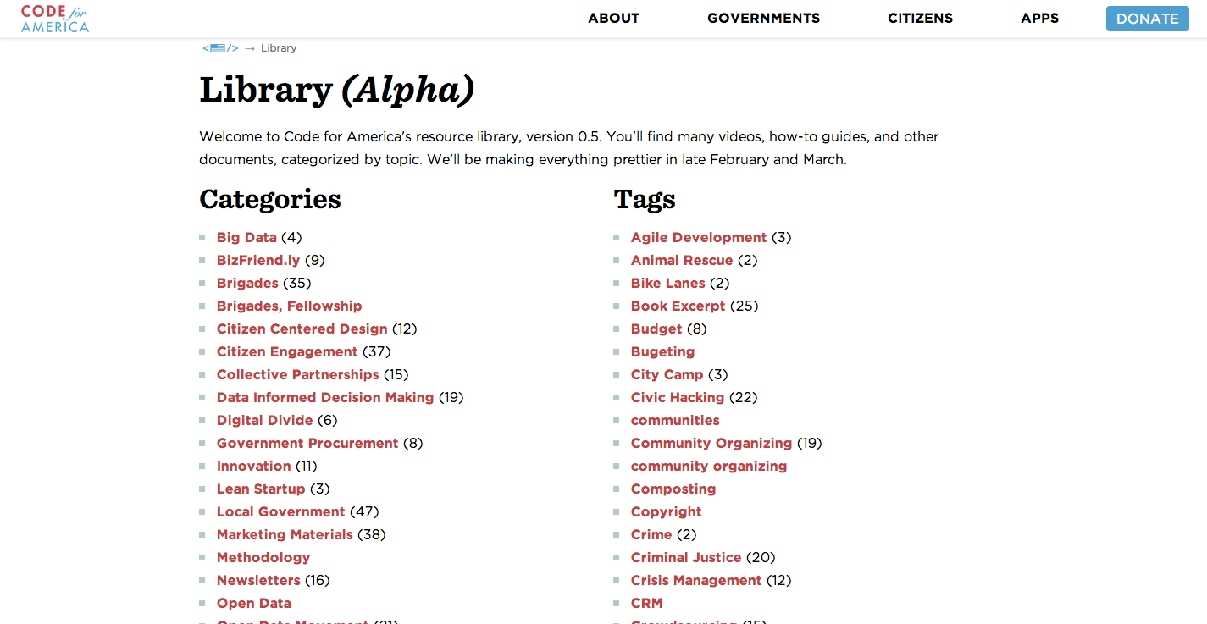
Notes:
Typography

Slide 5
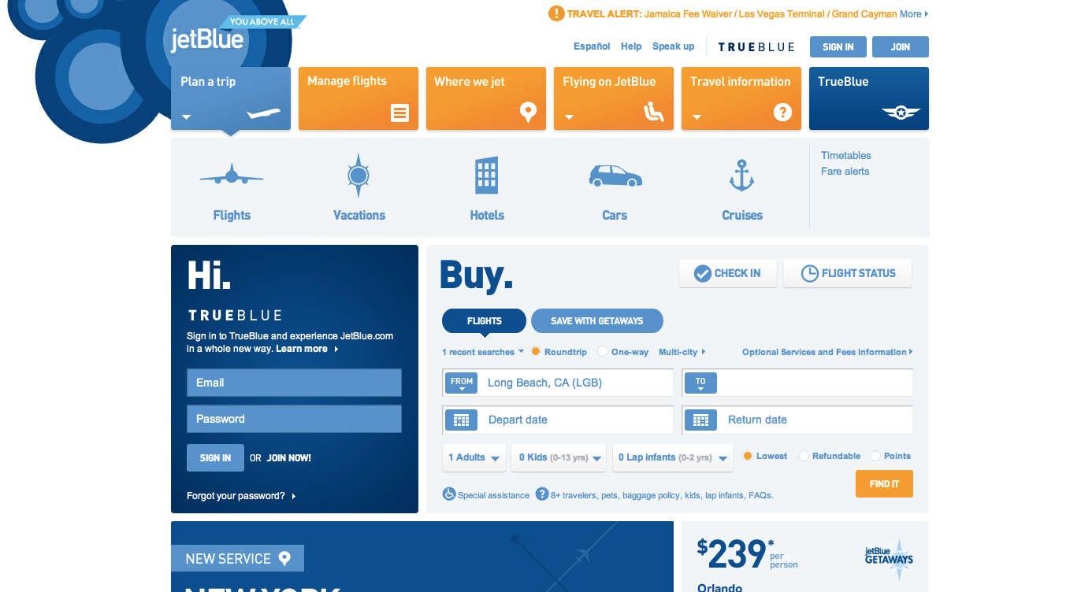
Notes:
Color

Slide 6
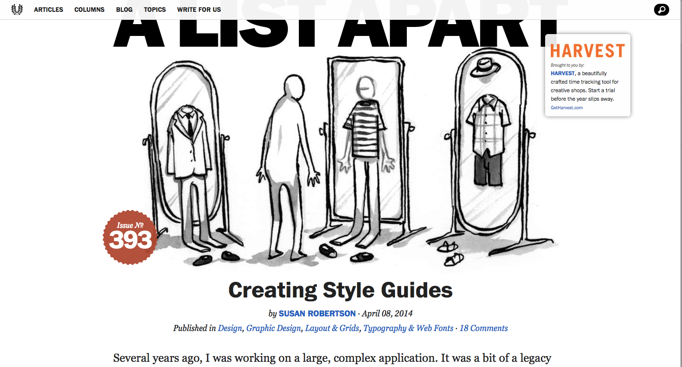
Notes:
imagery

Slide 7
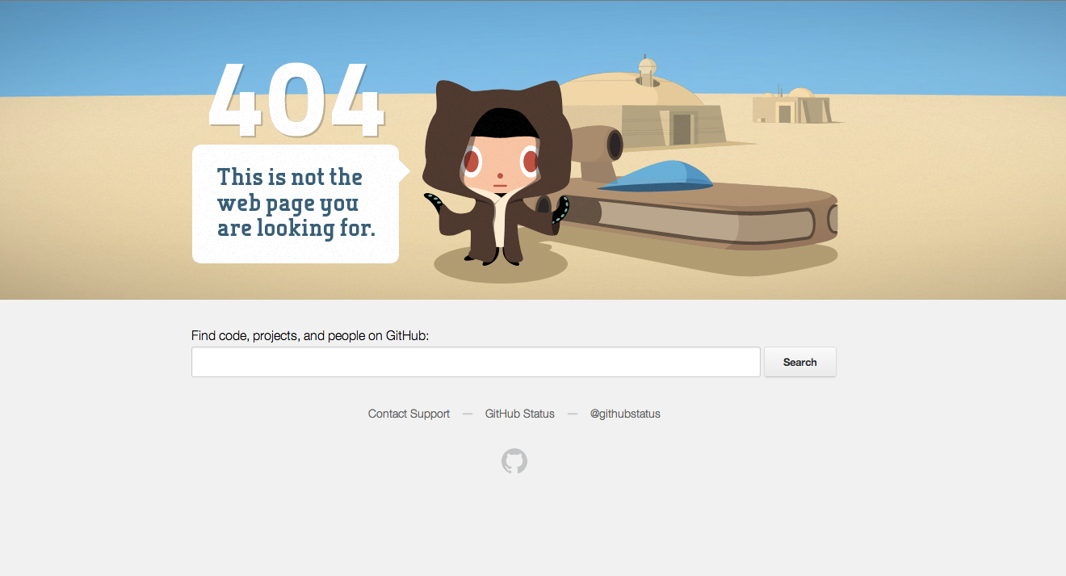
Notes:
Voice

Slide 8
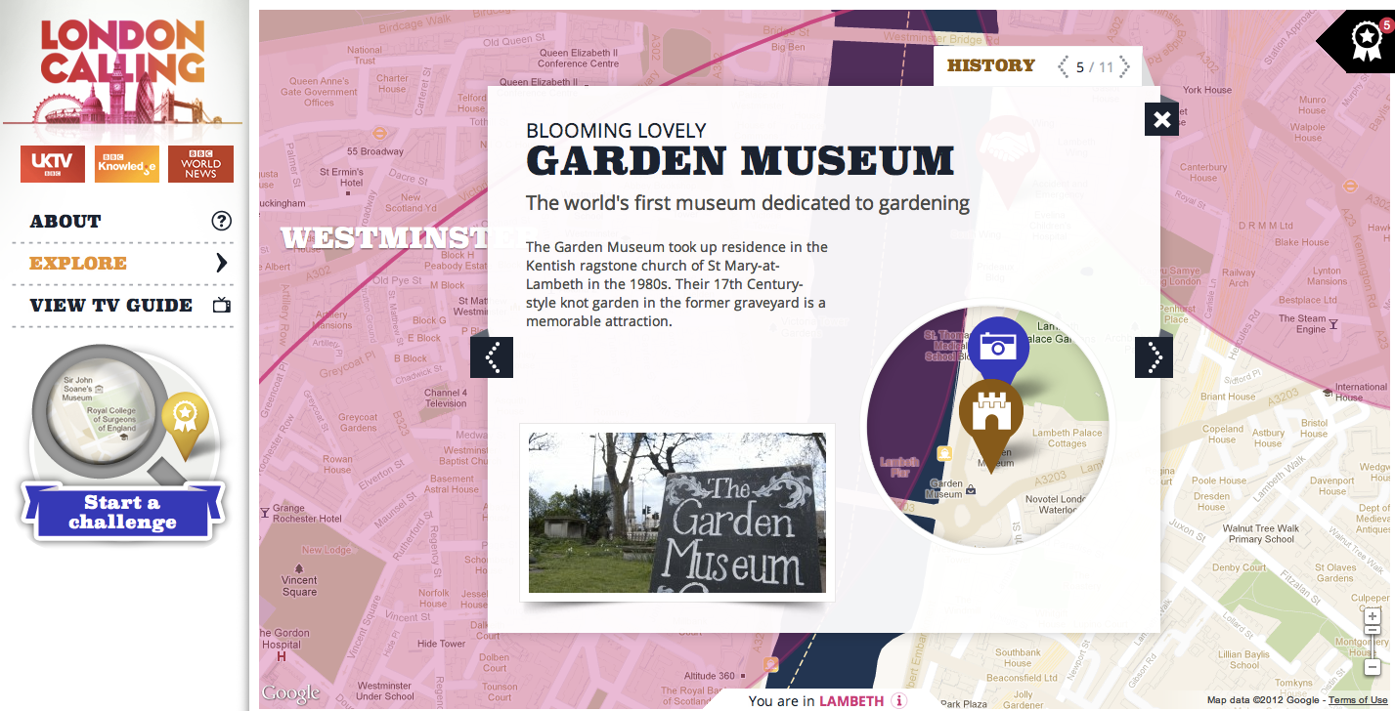
Style guides
Pattern Library

Slide 9
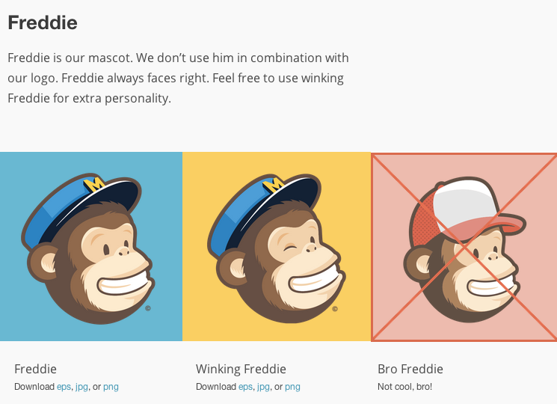
For designers internal + external
http://mailchimp.com/about/brand-assets/
https://ux.mailchimp.com/patterns/
Notes:
Styles guides are brand guidelines for both internal and external designers. Patterns libraries also help give examples of usage. It simplifies and keeps a consistent style especially when you have more than 1 designer.

Slide 10
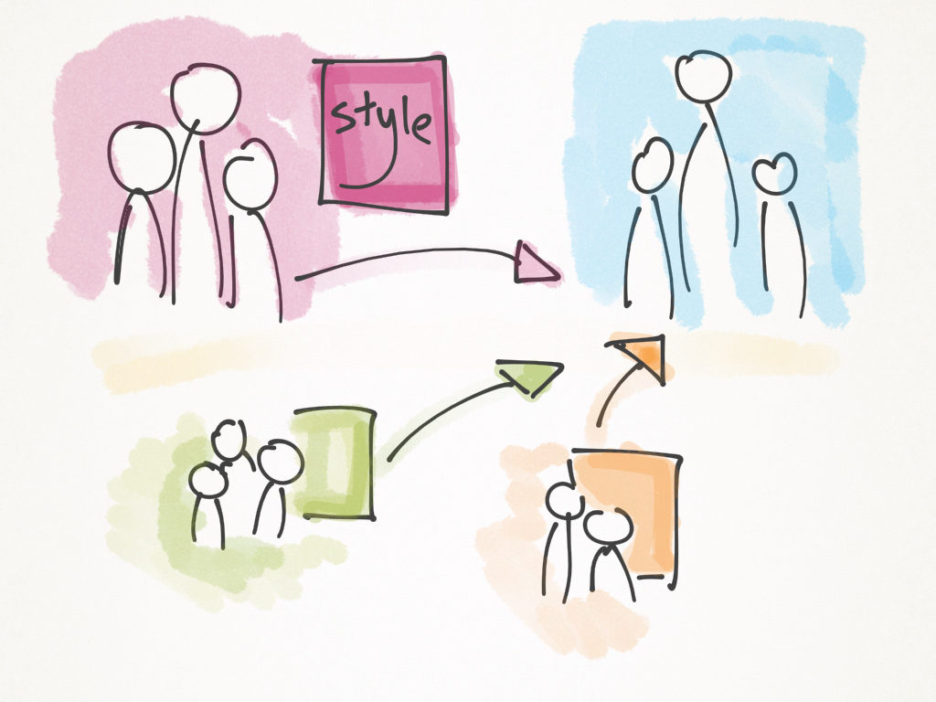

Slide 11
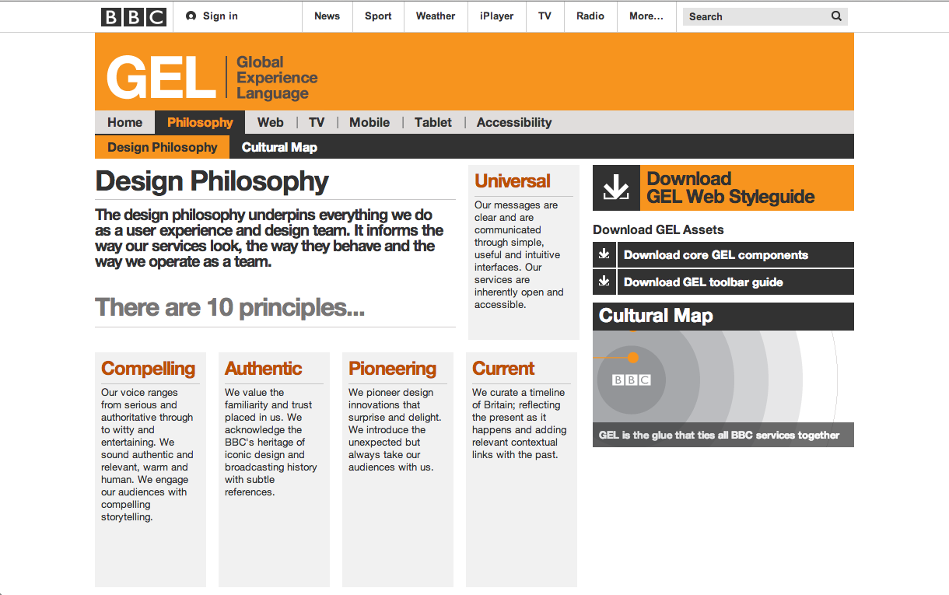
Notes:
Talk about philosophy

Slide 12
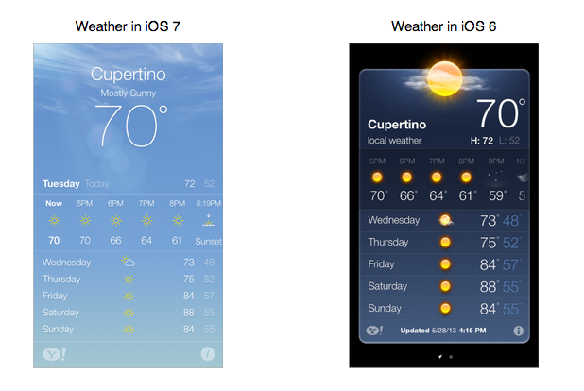
Notes:
Major themes of design – what’s changed…

Slide 13
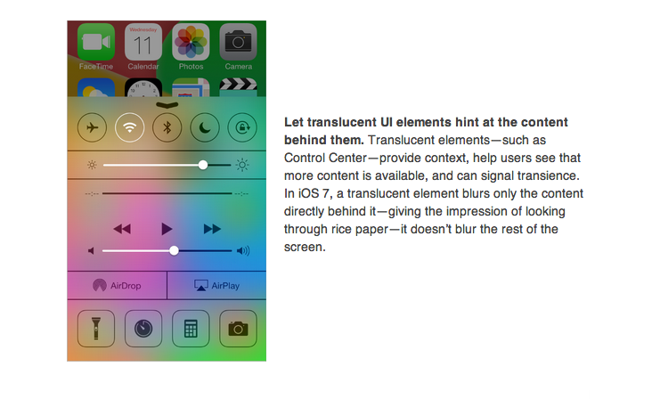
Notes:
Explain the design themes

Slide 14
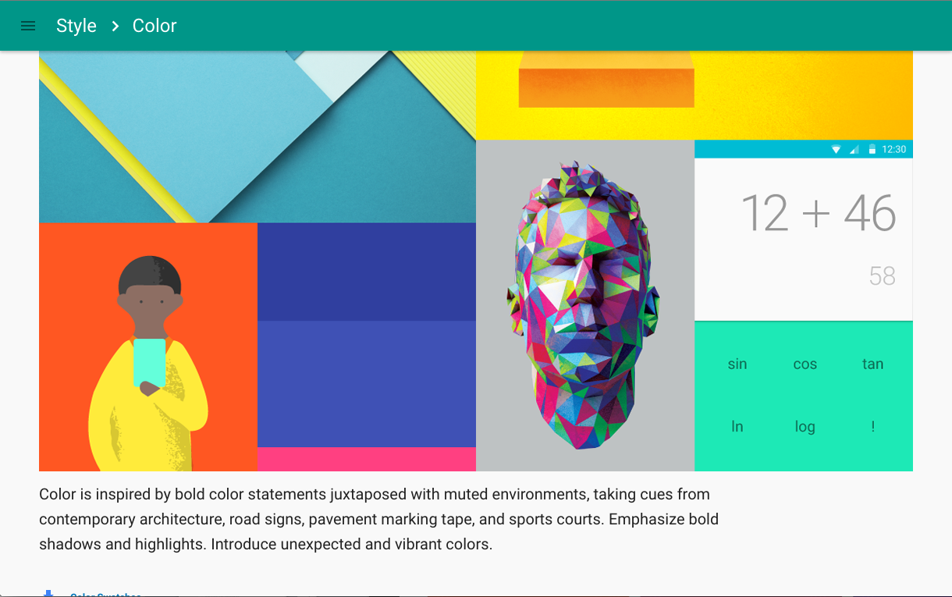

Slide 15
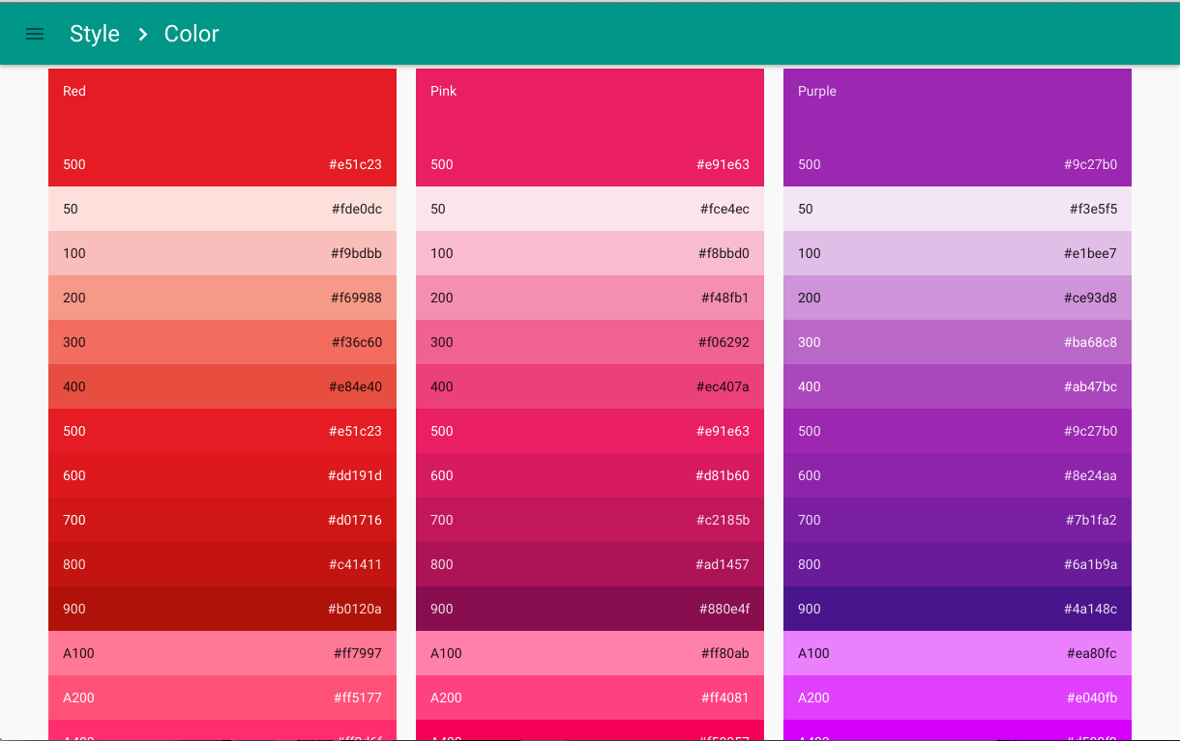
Notes:
Color codes

Slide 16
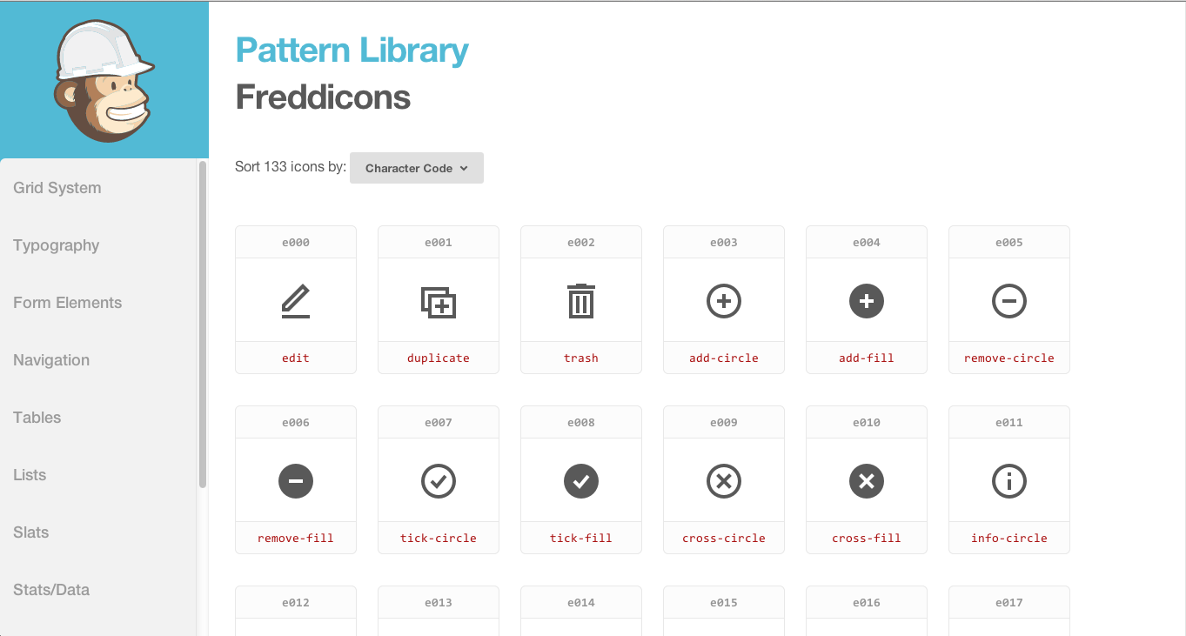
Notes:
I

Slide 17
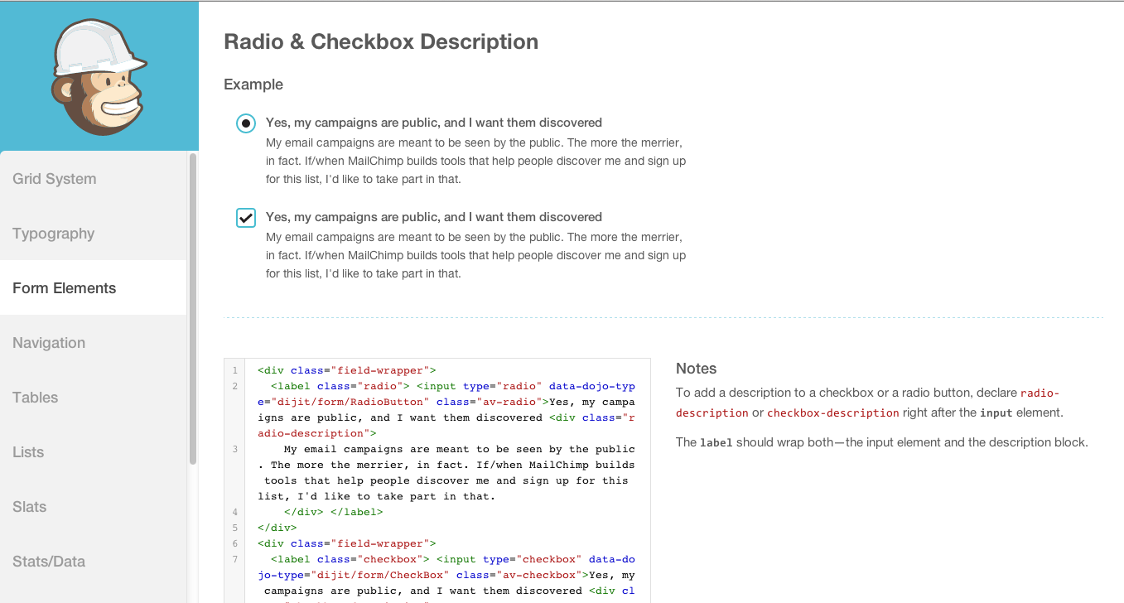
Notes:
Patterns, how to use

Slide 18
Find the branding

Slide 19
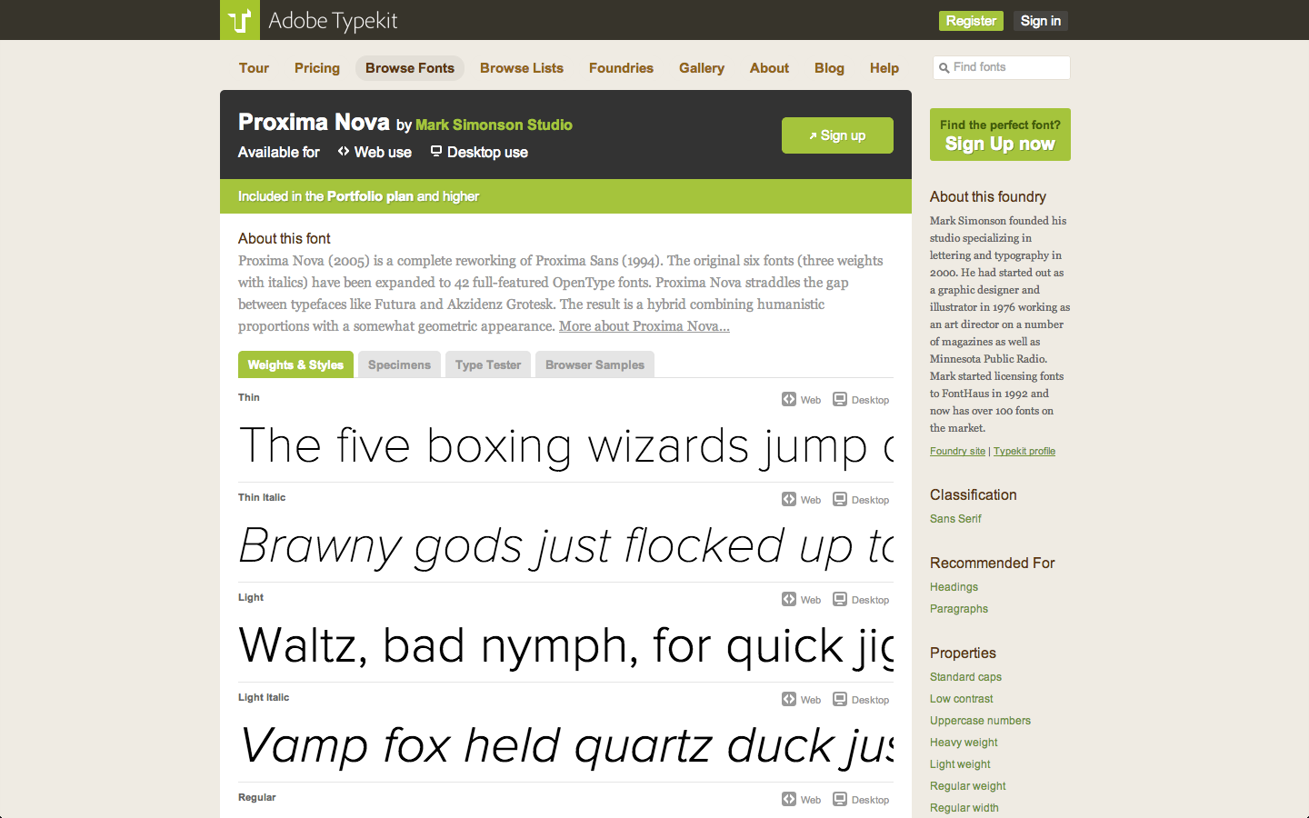
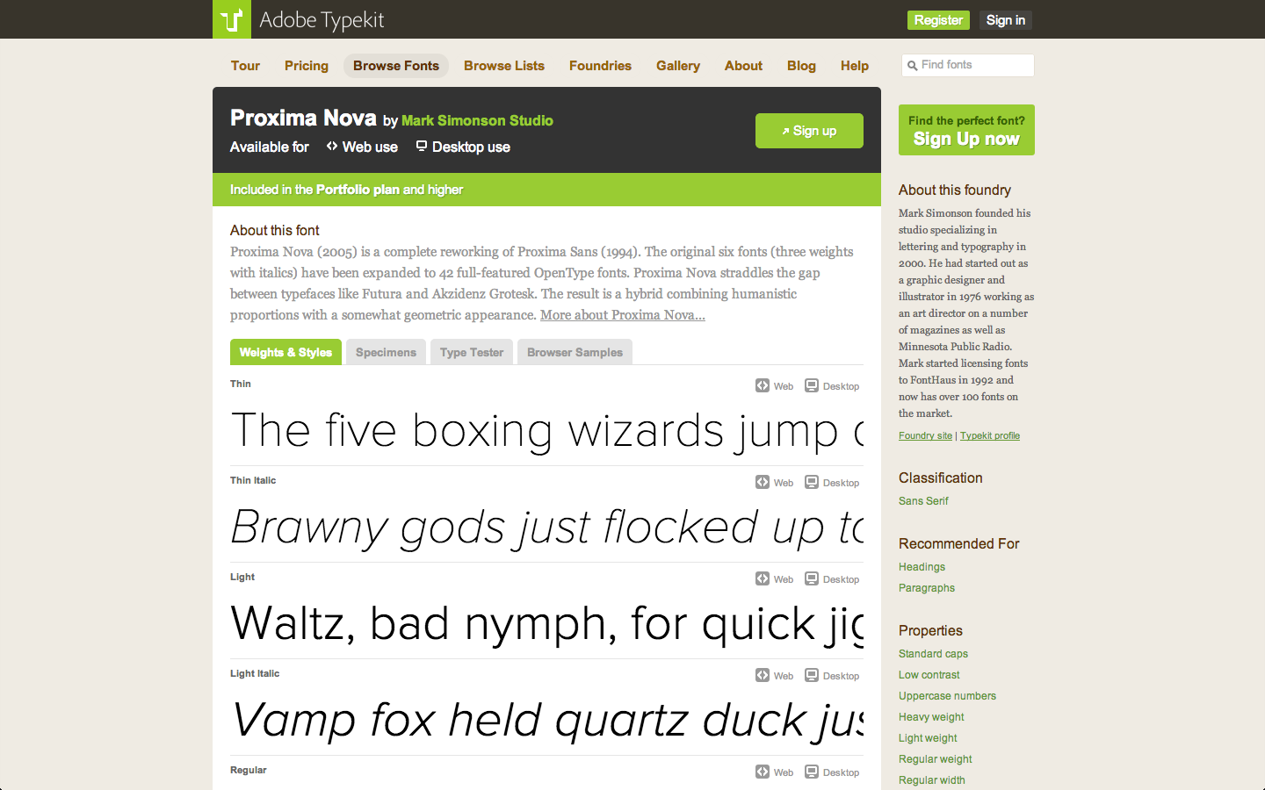

Slide 20
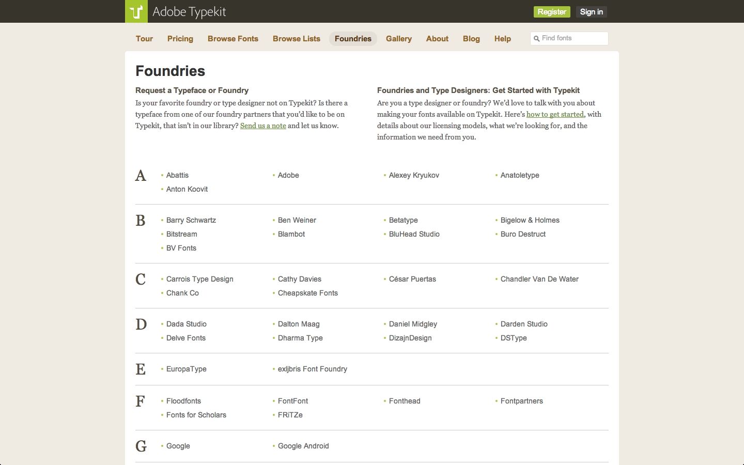
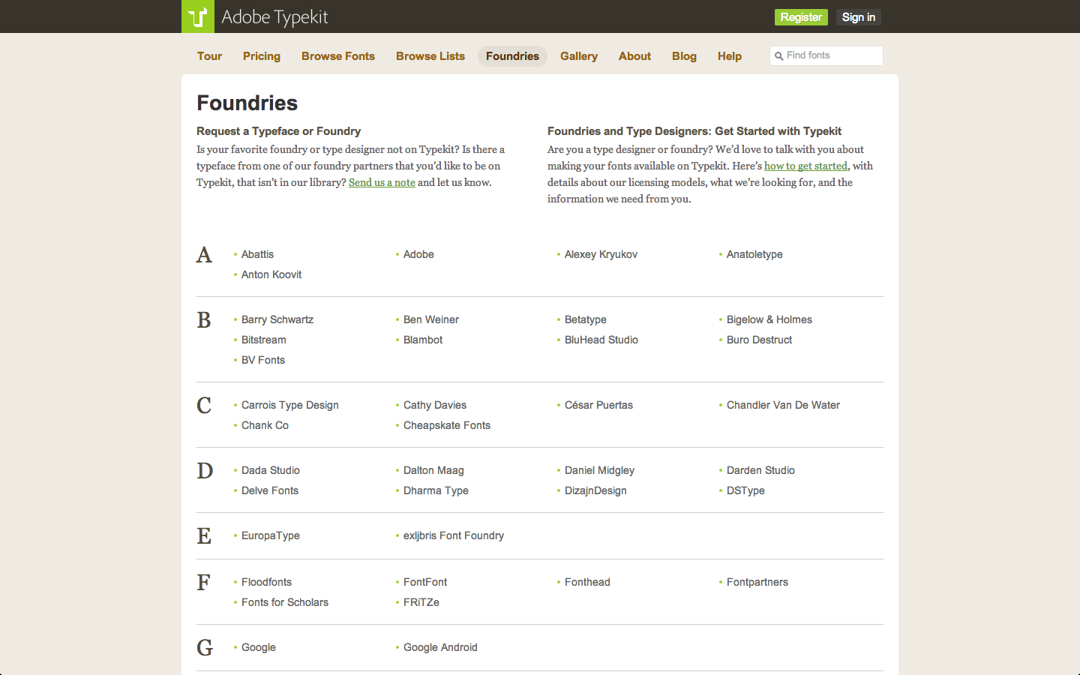

Slide 21


Slide 22


Slide 23
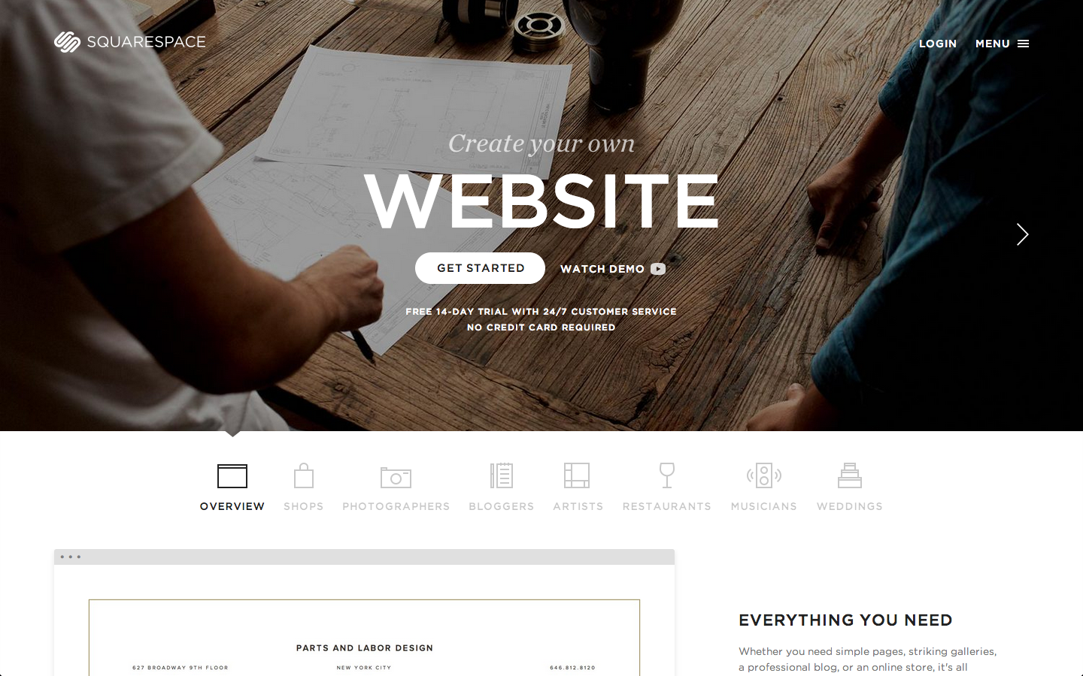

Slide 24


Slide 25
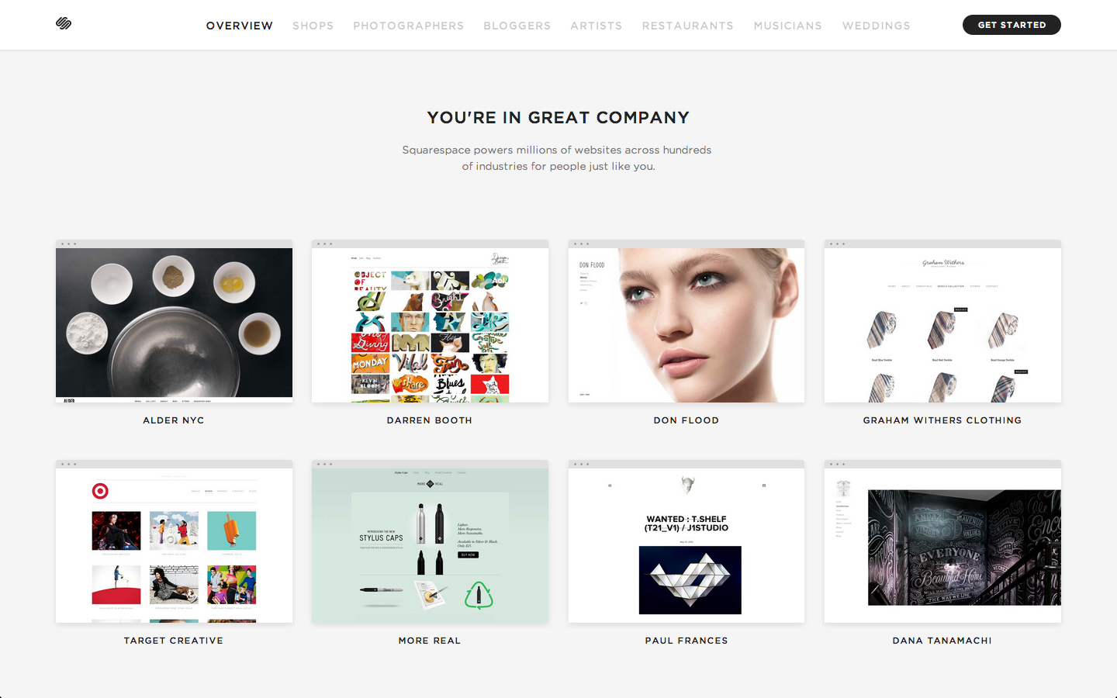

Slide 26
What is your brand?

